Slide 1

Setting up your ML application
Train/dev/test
sets
deeplearning.ai

Slide 2

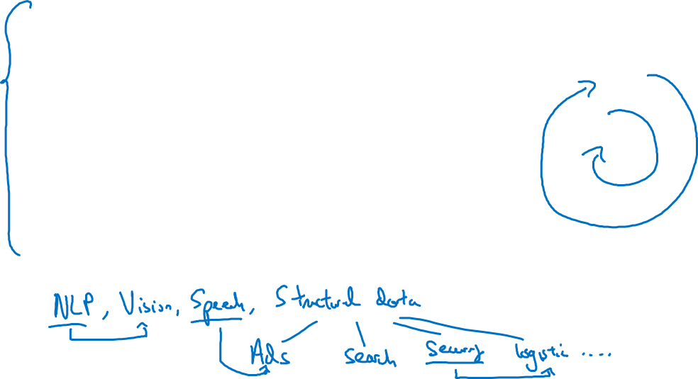
Applied ML is a highly iterative process
# layers
Idea
# hidden units
learning rates
activation functions
…
Experiment
Code

Slide 3
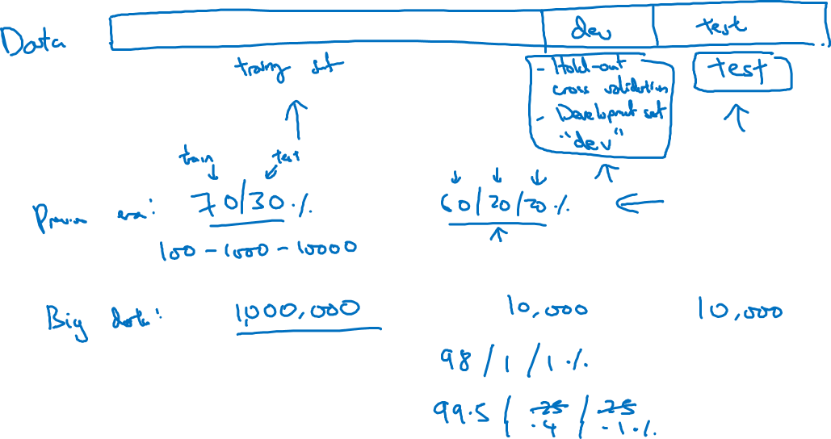
Train/dev/test sets

Slide 4
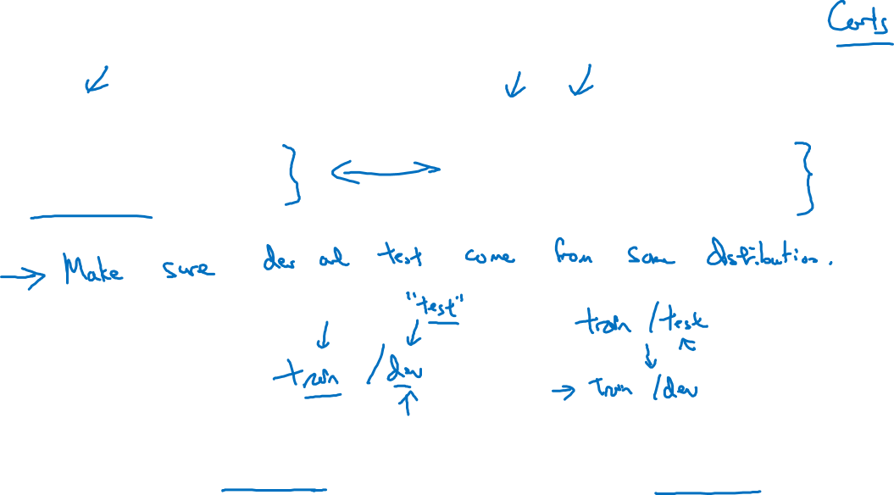
Mismatched train/test distribution
Training set:
Cat pictures from webpages
Dev/test sets:
Cat pictures from users using your app
Not having a test set might be okay. (Only dev set.)

Slide 5
Setting up your ML application
Bias/Variance
deeplearning.ai

Slide 6
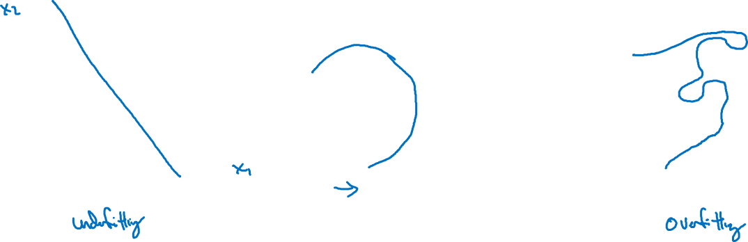
Bias and Variance
high bias
“just right”
high variance

Slide 7
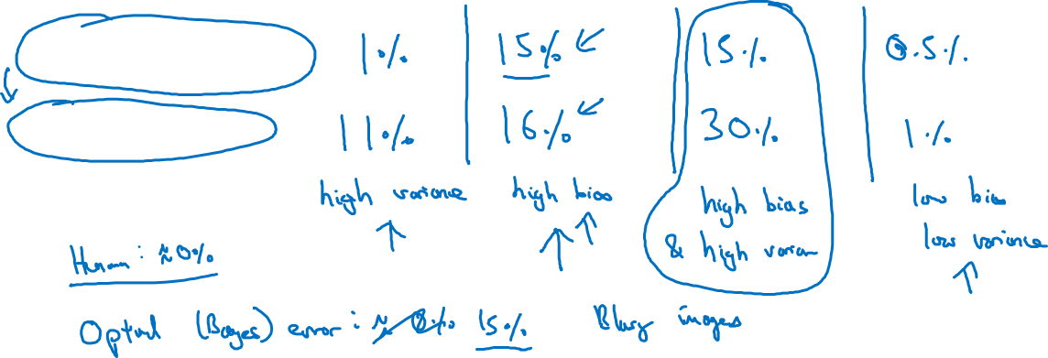
Bias and Variance
Cat classification
Train set error:
Dev set error:

Slide 8
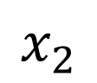
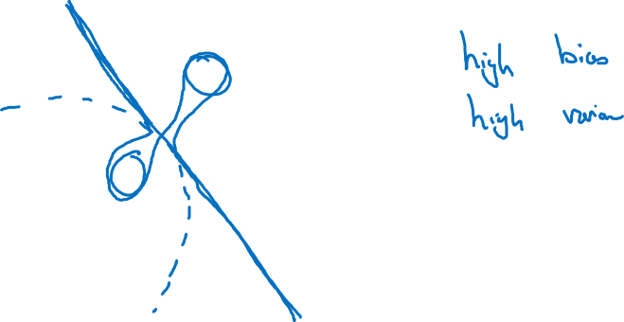
High bias and high variance
$$x_{2}$$
$$x_{1}$$

Slide 9
Setting up your ML application
Basic “recipe”
for machine learning
deeplearning.ai

Slide 10
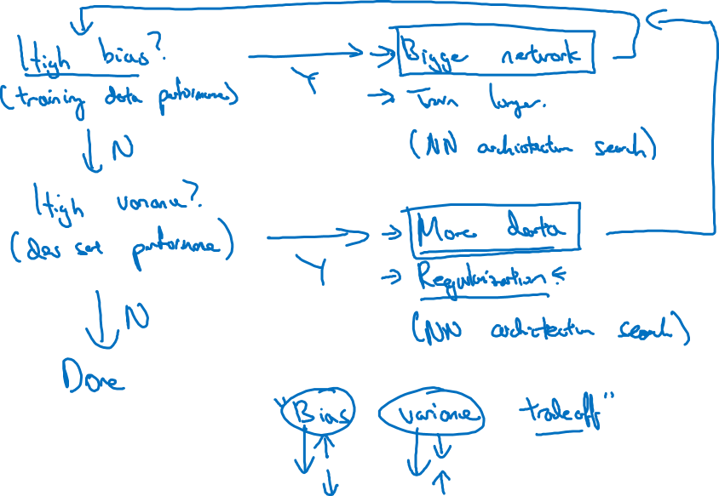
Basic recipe for machine learning

